Slide 1
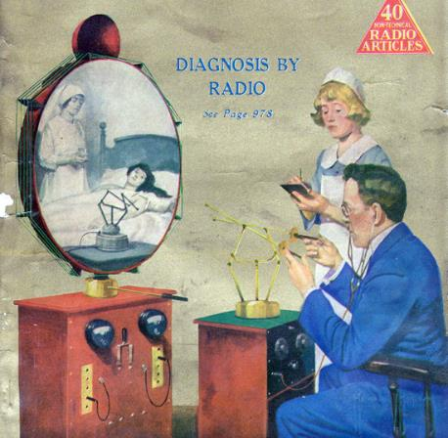
Telehealth/Telemedicine
Bob Marshall, MD MPH MISM FAAFP Program Director, DoD/MAMC Clinical Informatics Fellowship

Slide 2
Learning Objectives
Review the definitions and goals/reasons for Telemedicine
Discuss the potential and real benefits offered by Telemedicine
Review both the modes and delivery mechanisms for Telemedicine
Review the common categories of Telemedicine services currently offered

Slide 3
Definition #1 - Telehealth
According to the Office for the Advancement of Telehealth (OAT), Telehealth is defined as:
“the use of electronic information and telecommunications technologies to support long-distance clinical health care, patient and professional health-related education, public health and health administration”

Slide 4
Definition #2 - Telemedicine
According to the American Telemedicine Association:
What was, until recently, referred to as telemedicine now encompasses a much broader array of services and technologies – AI, virtual reality and behavioral economics – just to name a few
Technology-enabled health and care management and delivery systems that extend capacity and access.

Slide 5
Goal of and reasons for Telemedicine 1
The goal of telemedicine ultimately is to provide timely and high quality medical care remotely.
Telemedicine is becoming increasingly popular for the following reasons:
(1) With the rising cost of healthcare worldwide, newer delivery models are appearing that will include telemedicine.
In the case of the United States where Medicare will not reimburse for readmission for certain diseases new strategies are needed to prevent readmissions, to include telemedicine.

Slide 6
Goal of and reasons for Telemedicine 2
(2) There is a shortage of primary care and intensivist physicians.
Moreover, they are maldistributed to urban and not rural areas.
Remote delivery of medical care with telemedicine is a partial fix
(3) Additional means are needed to deliver medical care, given the rise in chronic diseases and our graying population.
(4) Telemedicine results in improved collaboration among physicians and disparate healthcare organizations.
(5) Telemedicine raises patient satisfaction when it results in better access to specialty care, less time lost from work and/or fewer long distant trips to tertiary medical centers

Slide 7
Telemedicine Reimbursement
Increasingly payment models are either implicitly or explicitly calling for the use of Telemedicine tools
The Merit Based Incentive Payment System (MIPS) provides opportunities for the use of telehealth services to increase access to care and provide population health outreach
In addition, CMS continues to evaluate waivers for the deployment of telemedicine services as outlined in updates to the comprehensive joint replacement (CJR) bundled payment

Slide 8
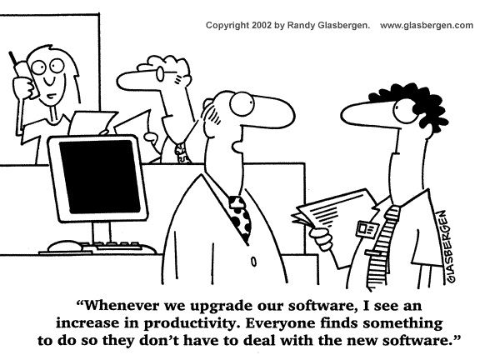
MHS GENESIS Upgrades?

Slide 9
Telehealth Benefits 1 of 2
Improved Access – Since its inception, telehealth has been used to bring healthcare services to consumers in distant locations.
Telehealth not only improves consumer access, it extends the geographic reach and expertise of physicians and health facilities
Cost Efficiencies – Reducing or containing the cost of healthcare is one of the strongest motivators to fund and adopt virtual care technologies

Slide 10
Telehealth Benefits 2 of 2
Improved Quality – Studies have consistently shown that the quality of healthcare services delivered via telehealth are as good as those given in traditional in-person consultations.
In some specialties, particularly in mental health and ICU care, telehealth delivers a superior product, with greater outcomes and consumer satisfaction.
Consumer Demand – The greatest impact of telehealth is on the consumer, their family and their community.
Using telehealth technologies reduces travel time and related stresses for the consumer

Slide 11
Modes/Services Provided 1 of 2
Live videoconferencing (synchronous) – the delivery of a live, interactive consultationbetween Primary care and specialist health services
Store and forward (asynchronous) – the use of store and forward transmission of diagnostic images, vital signs and/or video clips along with patient data for later review that enables a primary care or allied health professional providing a consultation the ability to render a diagnosis

Slide 12
Modes/Services Provided 2 of 2
Remote patient monitoring (RPM) – including home telehealth, uses devices to remotely collect and send data to a home health agency or a remote diagnostic testing facility (RDTF) for interpretation
Mobile health (mHealth) – Consumer medical and health information includes the use of the internet and wireless devices for consumers to obtain specialized health information and online discussion groups to provide peer-to-peer support

Slide 13
Delivery Mechanisms 1 of 2
Networked programs link tertiary care hospitals and clinics with outlying clinics and community health centers in rural or suburban areas
The links may use dedicated high-speed lines or the Internet for telecommunication links between sites
Point-to-point connections using private high-speed networks are used by hospitals and clinics that deliver services directly or outsource specialty services to independent medical service providers

Slide 14
Delivery Mechanisms 2 of 2
Monitoring center links are used for cardiac, pulmonary or fetal monitoring, home care and related services that provide care to patients in the home
Often normal land-line or wireless connections are used to communicate directly between the patient and the center although some systems use the Internet
Web-based e-health consumer service sites provide direct consumer outreach and services over the Internet
Under telehealth, these include those sites that provide direct consumer care

Slide 15
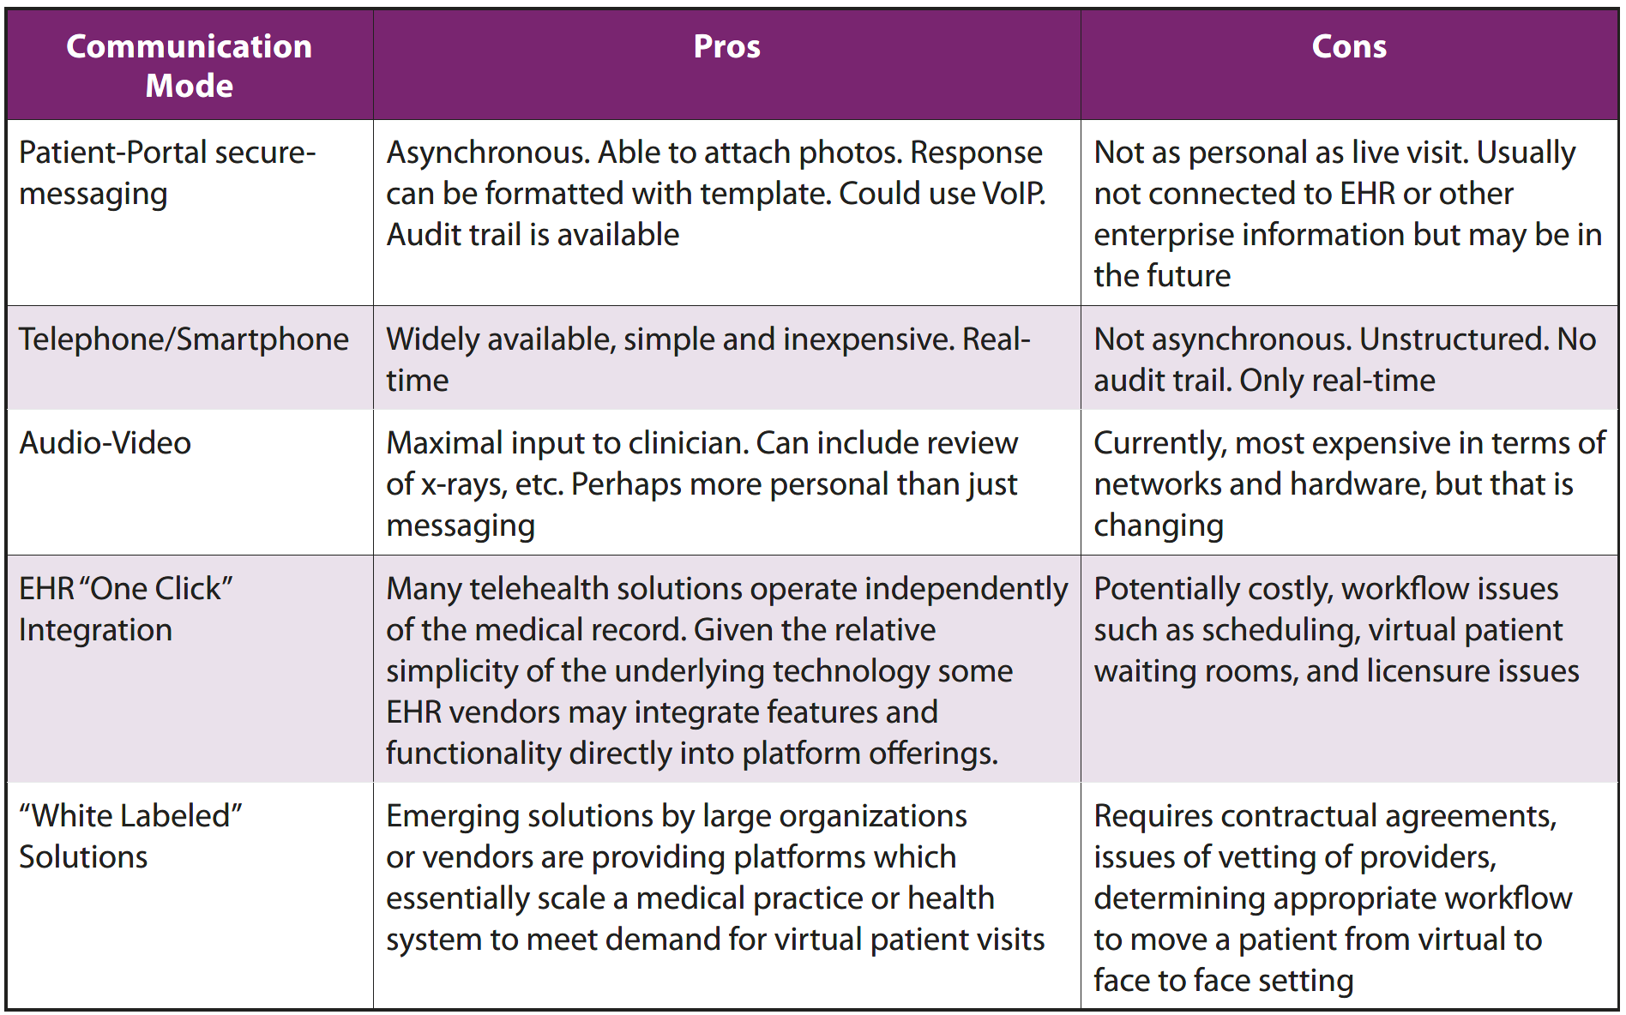

Slide 16
Telemedicine Categories
Virtual patient visits (televisits or e-visits) could be part of telemedicine or consumer health informatics
Teleconsultations: teleradiology, teledermatology, televisits, etc.
Telehealth: the use of remote health care technology to deliver clinical services
Telemonitoring:
Telerounding: hospital inpatients
Telehomecare: monitoring physiological parameters, activity, diet, etc. at home

Slide 17
Teleconsultations - Overview
Teleconsultation is a worldwide phenomenon because specialists tend to practice in large metropolitan areas, and not in rural areas
Most programs consist of a central medical hub and several rural spokes
The most commonly delivered services are mental health, dermatology, cardiology and orthopedics
According to the American Telemedicine Association (ATA), as of 2018 there about 200 telemedicine networks and 3,500 practice sites

Slide 18
Teleradiology 1 of 2
vRad (formerly NightHawk Radiology Services) helps smaller hospitals by supplying radiology services remotely
All are board certified; most trained in the United States and carry multiple state licenses
They list a staff of 500+ radiologists (70% are subspecialty trained) and interpret seven million studies per year
They offer conventional radiology as well as CT, MRI, Ultrasound and Nuclear Medicine interpretation

Slide 19
Teleradiology 2 of 2
In mid-2013 The American College of Radiologists published Teleradiology Practice Guidelines
Another common example of teleradiology is the practice of radiologists reading films after-hours at home
They must have high resolution monitors and high-speed connections to the Internet
This is becoming the standard practice for radiologists

Slide 20
Teleneurology
Many regions lack neurologists to see patients with stroke-like symptoms to determine if they need thrombolytics or need to be transferred to a higher level of care
With the advent of telemedicine, the case can be discussed real time and the patient, and their x-rays can be viewed remotely by a stroke specialist
Teleconcussion is a new indication for teleneurology consultation whereby a patient with head trauma is evaluated remotely

Slide 21
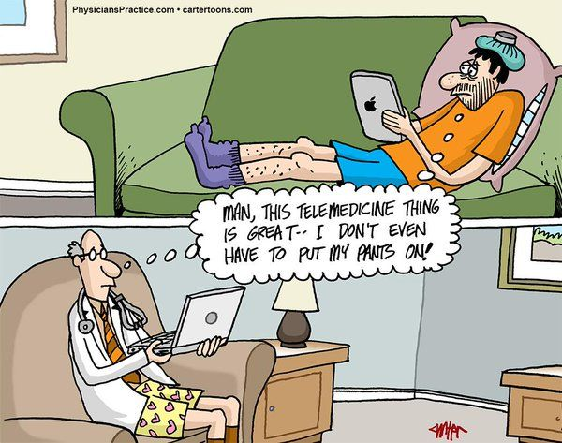

Slide 22
Telepharmacy
Like teleradiology, this field arose because of the shortage of pharmacists to review prescriptions
Vendors now sell systems with video cameras to allow pharmacists to approve prescriptions from a remote location
This is very important at small medical facilities or after-hours when there is not a pharmacist on location
A 2011 survey documented that 60% of hospitals have 24-hour review of medication orders by pharmacists and 11% use a telepharmacy company

Slide 23
Telepsychiatry/Telemental Health 1 of 5
The shortage of mental health professionals has helped to drive telemental health (also called telemental health) services
Several studies have indicated that telepsychiatry is equivalent to face-to-face psychiatry for most patients
The American Psychiatric Association promotes telepsychiatry, primarily for remote or underserved areas, using live video teleconferencing

Slide 24
Telepsychiatry/Telemental Health 2 of 5
During a telesession, there can be individual or group therapy, second opinions and medication reconciliation
In general, virtual visits help team medicine and patient satisfaction has been good
On the American Psychiatric Association web site, there are valuable telemental health resources
Another telepsychiatry trend that is appearing is the use of free commercial-off-the-shelf (COTS) audiovisual programs, such as Skype

Slide 25
Telepsychiatry/Telemental Health 3 of 5
A comprehensive resource “The Online Couch” was published in 2012 that categorized technology-enabled treatment of depression into: computer-based cognitive behavioral therapy (CCBT), online counseling, online social networks, mobile platforms, games and virtual reality
The report makes the point that depression is extremely common in the adult population and because there is a shortage of mental health providers, a cost barrier and stigma associated with mental health visits, alternative approaches are needed

Slide 26
Telepsychiatry/Telemental Health 4 of 5
The web site Telemental Health Technologies Compared offers the ability to search for applications focused on private practice, provider networks, the enterprise and the consumer
This comparison web site makes the point that 38 state counseling boards have policies addressing online counseling and 18 states mandate that telemental services be reimbursed at the same level as face-to-face therapy

Slide 27
Telepsychiatry/Telemental Health 5 of 5
A 2015 review of telepsychiatry reported that telepsychiaty works well for post-traumatic stress disorder (PTSD), depression, and ADHD, and works well for underserved groups such as American Indian, Hispanic, and Asian populations
A 2016 systematic review of telepsychiatry demonstrated that overall, patients and clinicians were satisfied with telepsychiatry services
The review also showed that telepsychiatry is not more expensive than face-to-face delivery of mental health services and in fact may be more cost-effective

Slide 28
Teledermatology 1 of 2
With the advent of good quality digital cameras and cell phones with medium quality cameras, the concept of teledermatology was born
Teledermatology can reduce the need for face-to-face visits with a Dermatologist and can help with education and training of clinicians
The correlation between face-to-face evaluations and store and forward images from cameras or cell phone cameras is high

Slide 29
Teledermatology 2 of 2
Direct Derm is a web service for patients to upload pictures of their skin problem and receive recommendations from a team of US board-certified dermatologists within 2 business days
They also offer the ability for physicians to submit patient dermatology issues and photographs
The service costs $85 and is not submitted to third party payers
This platform is supported by the California Healthcare Foundation and Kresge Foundation

Slide 30
Teleophthalmology 1 of 2
The most common indication for teleophthalmology is imaging the retina (teleretinal screening) of patients at risk
Diabetic patients constitute the group most frequently followed due to serious complications, such as blindness related to their diabetes
Some ocular lesions are amenable to photo-coagulation, so early intervention is important
Fewer than 50% of diabetics receive annual screening

Slide 31
Teleophthalmology 2 of 2
Traditionally, patients would schedule an appointment with an ophthalmologist, but largely due to the additional expense, many patients were not seen
The newer trend is to have patients screened with a digital camera device in a primary care office and the images interpreted as store-and-forward
Newer devices can image the retinal without dilating the pupil, an attractive option for patients
Those patients with any serious pathology are then referred to a retinal expert

Slide 32
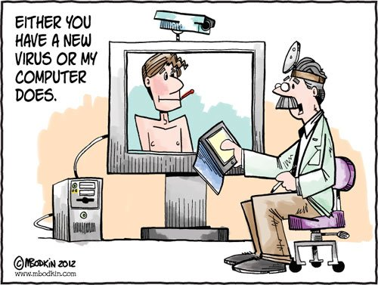
Questions/Discussion

